Slide 1
NAAN MUDHALVAN
DATA SCIENCE
PROJECT TITTLE:
STOCK PRICE PREDICTION
NAME:
ROOBAN KUMAR S

Slide 2

PROBLEM DEFINITION:
*The problem definition for stock price predictions using data science is to develop a data-driven approach that divides a company's stock price into distinct segments based on various criteria such as demographics, purchasing behavior, or preferences. * The objective is to uncover hidden patterns within the data and create meaningful stock price predictions.

Slide 3
DATA SET:
*Creating a stock price predictions dataset involves several steps, including defining the features, generating synthetic data, and ensuring data quality *Here's a simplified example of generating a dataset for stock price using Python and the popular libraries NumPy and Pandas:

Slide 4
```python import numpy as np import pandas as pd # Define the number of samples num_samples = 1000 # Generate synthetic data for stock price predictions np.random.seed(0) age = np.random.randint(18, 70, num_samples) income = np.random.randint(20000, 150000, num_samples) ```

Slide 5
purchase_frequency = np.random.randint(1, 20, num_samples) loyalty_score = np.random.randint(1, 11, num_samples) # Assuming a loyalty score out of 10 # Create a Pandas DataFrame data = { 'Age': age, 'Income': income, 'Purchase_Frequency': purchase_frequency, 'Loyalty_Score': loyalty_score } df = pd.DataFrame(data) # Save the dataset to a CSV file df.to_csv('customer_segmentation_dataset.csv', index=False) ```

Slide 6
# Save the dataset to a CSV file df.to_csv('stock price predictions _dataset.csv', index=False) ```
Text Act:
Software used in python

Slide 7
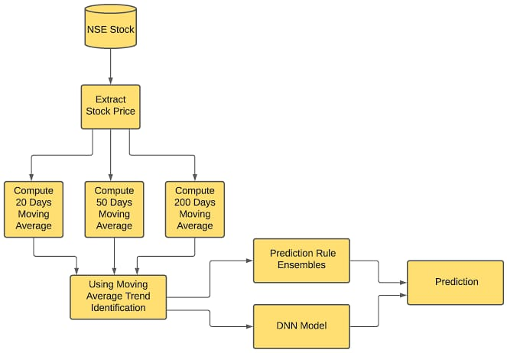
FLOWCHART:

Slide 8
Overview:
Problem Definition
Data set
Flow chart
Text Act

